Slide 1

Recommending Business IN Pune
Vijay Kumar

Slide 2
Business Problem
A person or businessman searches for a venue in a new city or want to open a new business, they’re highly interested in the best places that the city has to offer. The person might want to know what kind of business they can start in a particular area or what are the most common and best business present in location. If they know this valuable information then it certainly would help decide which business to open in a neighborhood around the city.

Slide 3
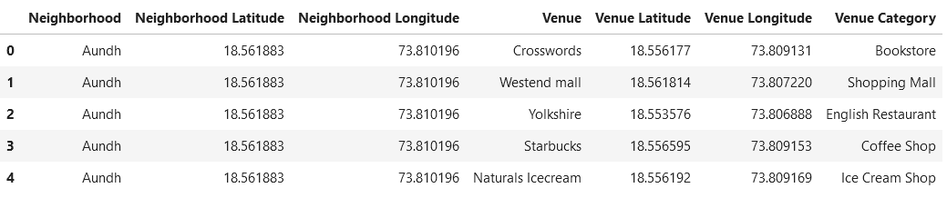
DATA DESCRIPTION
Data Requirements for this project:
Neighborhood Information (i.e. name, coordinates).
Venue information (i.e. name, category, coordinates)
Data Sources for this project:
Wikipedia Pages
Foursquare.com
Data Processing for this project:
Data cleaning is required
Data needs to be in a structured format

Slide 4
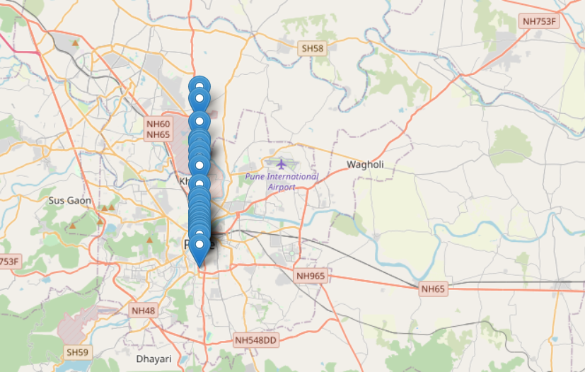
METHODOLOGY
Data Scrapping Technique
To scrap the neighborhood data from Wikipedia
To make the data into a structured format
Foursquare.com
Retrieving venue information from above API.
K-Means Machine Learning
Segment and cluster similar neighborhoods
Group them based on most common venues

Slide 5
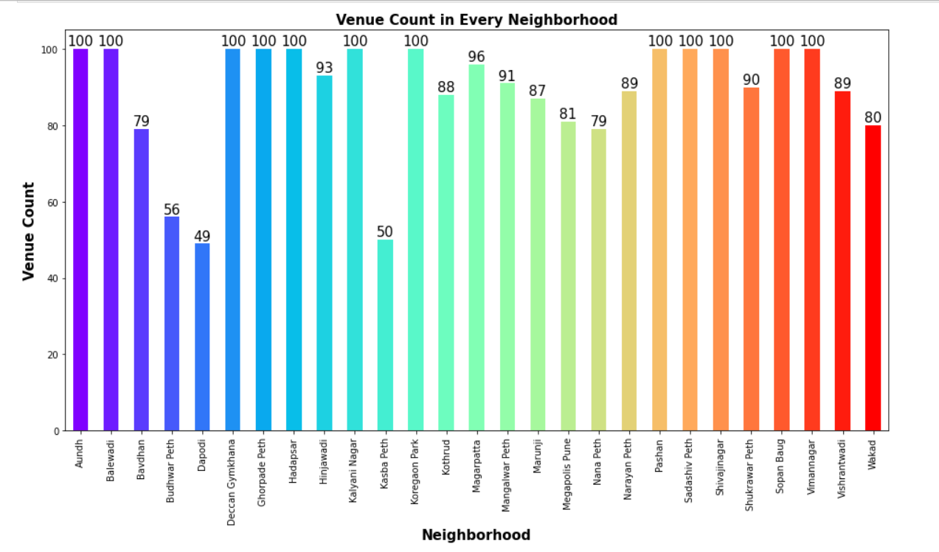
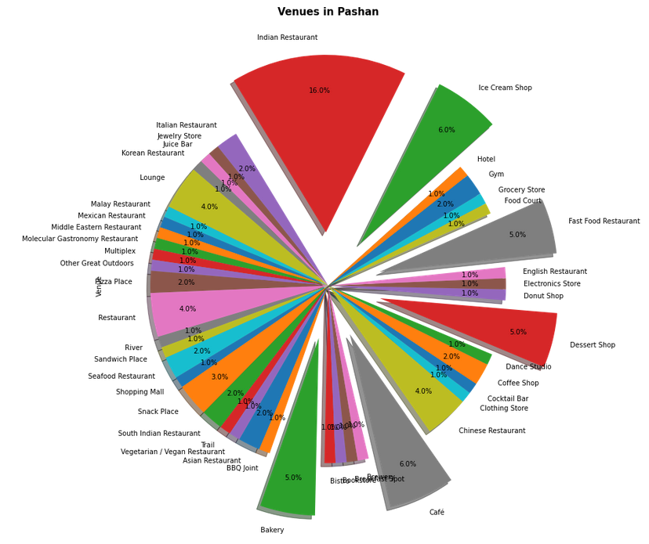
RESULT
Neighborhood with high number of venues
Ranking the neighborhoods based on venues count
Topmost common venue
Ranking the neighborhoods based on common venue.
Finding the Common venues in all Neighborhood.

Slide 6
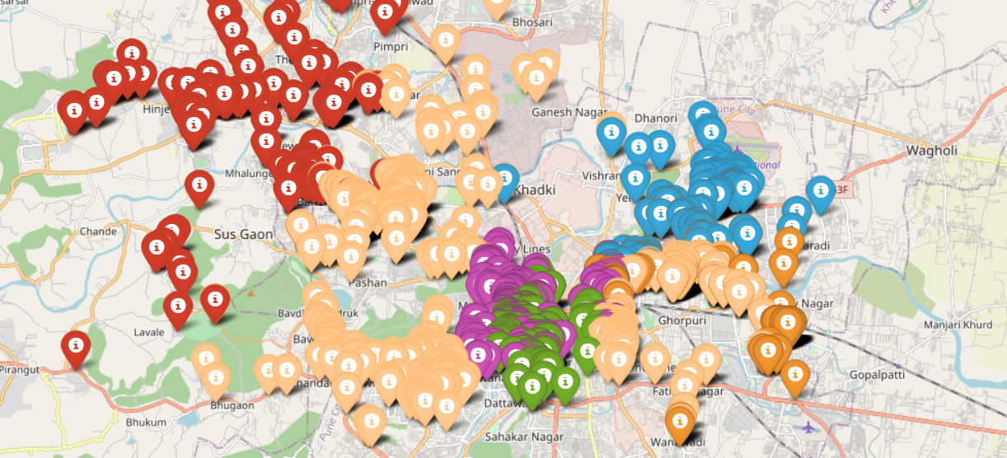
Clustering
To Identify the similarities in all venues, I used the K-Mean clustering algorithm to cluster them in 6 different group.
I used colour code to distinguish the cluster from other clusters.
Colour Orange represent Cluster 0
Colour Green represent Cluster 1
Colour Beige represent Cluster 2
Colour Red represent Cluster 3
Colour Blue represent Cluster 4
Colour Purple represent Cluster 5

Slide 7
DISCUSSION
Based on the result above, in all clusters Indian Restaurant is the most common followed by Fast-food. So, if you like to open any business you certainly don’t want to open an Indian restaurant specifically in neighbourhood which have 100 venues unless you have a backup budget.
You can think of a business which is neither least common nor most common in any of the neighbourhood, for example in Hinjewadi Most Common venue is Indian Restaurant and the lest common venue is a food court, reason may be because there are multiple Restaurant present in the area. But A Café, Sandwich place and a Pizza Place are neither most common nor least common, so opening a Sandwich place or a Café place might be a good idea

Slide 8
CONCLUSION
The purpose of this project is to explore different kind of venues and business in Pune city. We have concluded that if you focus on opening a particular business and if you have a backup budget then you can certainly open a business which is most popular in a particular area and if not, you can think of a business which is neither most common nor least common.
Project can be used to explore venues of any city and can take an idea what kind of business he/she can run in the city

